Slide 1
Day 9 — JSX and React Components
MERN Stack Bootcamp(JavaScript)
Instructor: Abid Ali

Slide 2
Learning outcomes
Write valid JSX including expressions, className, and fragments.
Create and compose function components with export/import.
Pass and receive props and render lists with stable keys.
Navigate a Vite React project structure and run the dev server.
Refactor monolithic JSX into smaller reusable components.
Notes:
5 minutes. Ask: Who has run npm/vite before?

Slide 3
Agenda (~90 minutes)
Context: React mental model & toolchain refresh
JSX rules: expressions, attributes, fragments, lists
Function components, imports, composition, folders
Props: passing data, children, keys in lists
Patterns: when to split; recap & next steps
Notes:
Keep demos short; students mirror on laptops after lab.

Slide 4
Part 1 — React & toolchain

Slide 5
Why component-driven UI?
Split the UI into independent, reusable pieces.
Each piece (component) returns JSX describing what to render.
React reconciles updates efficiently against the DOM.
Today: static composition + props (state comes later in depth).
Notes:
Demo idea: show a tiny App.jsx changing text — hot reload.

Slide 6
Modern React (what we use in this course)
Function components + JSX (no class components required).
Modules (ESM): import/export between files.
Build tool: Vite — fast dev server & optimized production builds.
React 18+/19: root API createRoot; JSX transform handled by tooling.
Notes:
Avoid React.createClass — legacy. Mention hooks preview only.

Slide 7
Checkpoint — dev workflow
Terminal: npm run dev → keep it running during lecture/lab.
Browser + editor side-by-side — save file → UI updates (Fast Refresh).
If something breaks: read the error overlay first — line numbers point to JSX.
Notes:
30 seconds: everyone confirm localhost loads default Vite React screen.

Slide 8
What Vite does for us (high level)
Dev server: serves modules, transforms JSX on the fly.
Production build: bundles, minifies, hashes filenames for caching.
You mostly edit src/*.jsx — config stays minimal early on.

Slide 9
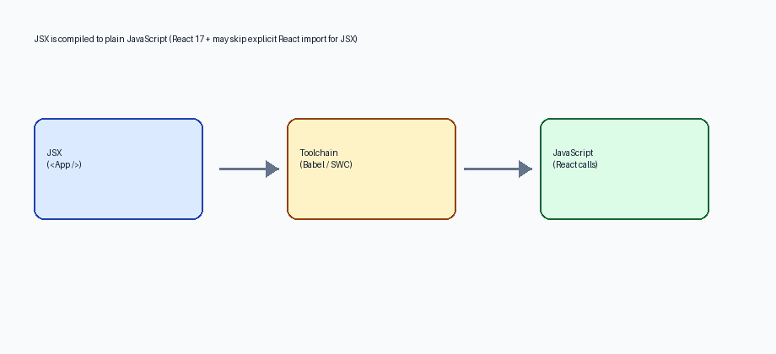
Diagram — JSX compilation pipeline
Your editor/source shows JSX; the bundler compiles it to JavaScript React can run.
Notes:
Ask: What file extension do we use for React in Vite? (.jsx)

Slide 10
Part 2 — JSX fundamentals

Slide 11
JSX is a syntax extension — not a string
Looks like HTML but lives inside JavaScript.
Must return a single root per component return (or use a fragment).
Curly braces {} embed JavaScript expressions.
className (not class) for CSS classes.

Slide 12
Attributes in JSX — camelCase everywhere
DOM/React synthetic events: onClick, onChange (camelCase).
ARIA / accessibility still matter: htmlFor links labels to inputs.
data-* attributes stay lowercase — passthrough to DOM.

Slide 13
Conditional UI in JSX
Use logical && when you want “render nothing OR something”.
Use ternary (cond ? a : b) when both branches are JSX/text.
Do not put if/for statements directly inside { } — assign to a variable first.

Slide 14
Patterns — && and ternary
function Status({ count }) { return ( <div className="status"> {count > 0 && <span>{count} items</span>} {count === 0 ? <p>Cart is empty</p> : null} </div> ); }
Notes:
Compare with students: when would you choose && vs ternary?

Slide 15
Expressions inside JSX
function Banner({ userName }) { const hour = new Date().getHours(); const greeting = hour < 12 ? "Morning" : "Hello"; return ( <header className="banner"> <p>{greeting}, {userName}!</p> <small>Year {new Date().getFullYear()}</small> </header> ); }
Notes:
Trap: {} expects expressions — not if/for statements (use ternary / &&).

Slide 16
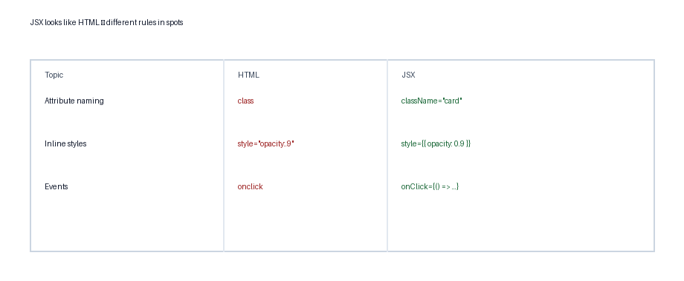
Diagram — JSX vs HTML habits
Memorize the JSX equivalents — Linters (ESLint) catch many mistakes.

Slide 17
Self-closing tags & booleans
Always close void elements in JSX: <img />, <input />, <br />.
Boolean props: <Button disabled /> equals disabled={true}.
Explicit false: <Button disabled={false} /> — omit prop when default is false.

Slide 18
Gotchas — JSX
Adjacent siblings need a parent or <>fragment</> / <React.Fragment>.
Comments in JSX: {/* comment */}
style takes an object: style={{ marginTop: 8 }} (camelCase keys).
Reserved words: htmlFor, className.

Slide 19
Fragments avoid extra DOM nodes
function Row() { return ( <> <span>Name</span> <span>Value</span> </> ); }

Slide 20
Rendering lists
Use Array.prototype.map to turn data → JSX.
Each top-level element in the loop needs a stable key prop.
Key helps React match items across renders — use IDs, not array index when possible.

Slide 21
List + key
function ProductList({ items }) { return ( <ul className="list"> {items.map((item) => ( <li key={item.id}>{item.name}</li> ))} </ul> ); }
Notes:
Show DevTools warning if key is missing.

Slide 22
Keys — prefer stable IDs over index
Good keys: database ids, UUIDs, stable business keys.
Index as key: only OK for static lists that never reorder/filter.
Changing keys forces React to recreate subtree — sometimes intentional.
Notes:
Quick poll: Why does reordering break with index keys?

Slide 23
End of Part 2 — checkpoint
You can embed {}, use className, fragments, and map + key.
Next: organize JSX into files/components and wire imports.
Optional 2-min stretch: add a list from a hard-coded array in App.jsx.

Slide 24
Part 3 — Components & composition

Slide 25
Function component shape
A function whose name starts with Uppercase (convention).
Returns JSX (or null).
Defined in its own file or alongside related helpers.
Exported default or named — stay consistent per folder.

Slide 26
Naming rule — PascalCase components
React treats lowercase tags as built-ins (<div>) vs components (<Card>).
File names often match: Card.jsx exports Card (team conventions vary).
Hooks start with “use” — not covered deeply today; reserve the prefix.

Slide 27
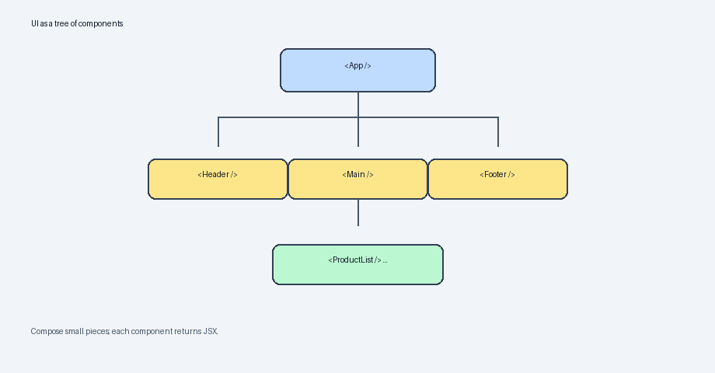
Diagram — component tree
Small components composed inside larger ones — data flows through props.

Slide 28
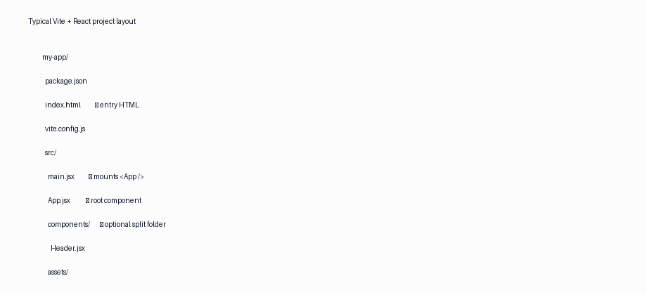
Diagram — Vite project layout
src/main.jsx mounts the tree; keep components under src/components as you grow.

Slide 29
Export / import (example)
// src/components/Header.jsx export function Header({ title }) { return <header><h1>{title}</h1></header>; } // src/App.jsx import { Header } from "./components/Header.jsx"; export default function App() { return ( <div className="app"> <Header title="Shop" /> </div> ); }
Notes:
Default export vs named export — pick one pattern per mini-project.

Slide 30
Default vs named exports (pick one style)
Named: export function Header … → import { Header } from "./Header.jsx"
Default: export default function App … → import App from "./App.jsx"
Mixing is fine — consistency inside a folder reduces confusion.

Slide 31
Imports — paths that bite beginners
Relative paths start with ./ or ../ — extension optional but explicit helps.
Case sensitivity: Linux CI may fail if import path casing mismatches filename.
Barrel files (index.js re-exports) exist — optional pattern later.

Slide 32
Composition patterns
Layout shells: App wraps pages/sections.
Presentational pieces: Card, Badge, Avatar.
Avoid copying JSX — extract when duplicate grows or needs props.

Slide 33
Checkpoint — composition
Can you draw arrows: App → Header → Nav on paper?
Does each component live in its own file yet? Refactor if App.jsx grows.
Prepare for props: decide what text/data parents must supply.

Slide 34
Part 4 — Props

Slide 35
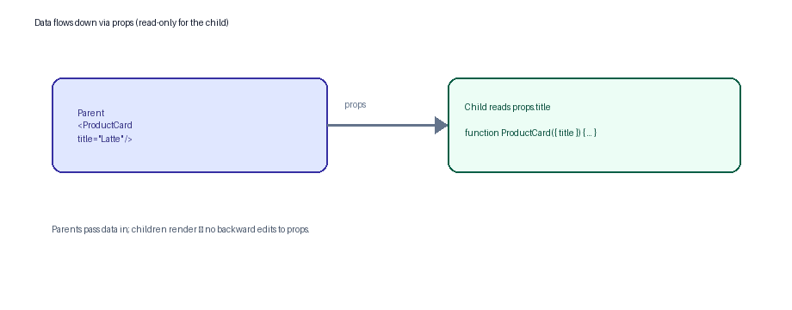
Diagram — props flow downward
Props are read-only inputs for a component — immutable snapshot each render.

Slide 36
Props mechanics
Props arrive as the first function argument object.
Destructuring: function Card({ title, price }) { … }
children prop: content between opening/closing tags.
Spread carefully: <Card {...data} /> when shapes match.

Slide 37
Default parameters for props
function Badge({ label = "NEW", tone = "muted" }) { return <span className={`badge badge--${tone}`}>{label}</span>; } // Usage: <Badge /> uses defaults <Badge label="SALE" tone="warn" />
Notes:
Defaults keep call sites short — override only what differs.

Slide 38
Spreading props
Helpful when an object already matches prop names: <Row {...item} />.
Risk: accidentally passing extra keys — TypeScript catches this later.
Order matters if you override: <Card {...defaults} title="Override" />.

Slide 39
children slot
function Panel({ title, children }) { return ( <section className="panel"> <h2>{title}</h2> <div className="panel-body">{children}</div> </section> ); } // Usage <Panel title="Details"> <p>Optional nested JSX goes here.</p> </Panel>

Slide 40
Gotchas — props
Props down — avoid mutating props inside children.
Rename reserved DOM props when forwarding… rarely needed today.
Boolean shorthand: <Toggle open /> === open={true}
Default values via default parameters or fallback rendering.

Slide 41
Debugging JSX quickly
Console + React error overlay: often pinpoints exact line.
Disable half the JSX return (comment blocks) to isolate bad expressions.
React DevTools Components tab: inspect props actually received.

Slide 42
Part 5 — Patterns & wrap-up

Slide 43
When to split a component?
Repeated markup with small variations → props.
File exceeds ~80–120 lines of JSX → extract sections.
Distinct responsibilities (form vs list vs header).
Prefer many small components over one mega-return.
Notes:
Activity (3 min): Point at any slide UI and name 3 candidate components.

Slide 44
Minimal preview — interactive UI later
Today focused on static rendering + props.
State & events get dedicated sessions (useState, lifting state).
Hooks rules apply only when you introduce stateful hooks.
Notes:
Tease: Next class connects buttons/forms to component state.

Slide 45
Summary — JSX
Expressions in {}; fragments for siblings; className not class.
style={{ }} objects; comments {/* */}; lists via map + stable keys.

Slide 46
Summary — Components & props
PascalCase components; compose trees; keep files focused.
Props flow down; destructuring + defaults simplify signatures.
children composes slots without extra prop drilling for simple layouts.

Slide 47
Homework suggestion
Finish Lab Day 9 exercises + stretch tasks.
Sketch on paper a component tree for a profile page (Avatar, Bio, Stats).
Skim React docs: Describing the UI — Components (overview).

Slide 48
Inclusive UI basics (carry forward)
Images: always provide meaningful alt text — JSX still uses plain alt="…".
Associate labels with controls via htmlFor / id pairs for forms (later session deep dive).
Semantic tags (<main>, <nav>) improve structure — combine with CSS classes.

Slide 49
Team hygiene — ESLint & formatting
Vite templates often ship ESLint rules for React — enable key and hooks rules early.
Prettier (or editor format-on-save) keeps JSX readable in group projects.
Fix warnings before they accumulate — especially hooks deps in future labs.

Slide 50
Pairs — 2-minute prompt
Partner A describes a checkout row (title, price, remove button).
Partner B names 2–3 components + props needed — no coding yet.
Swap roles with a different UI snippet.
Notes:
Keeps energy up before Part 4 props.

Slide 51
Lab preview — ties to today
You will scaffold Vite, extract Welcome/ProductCard, compose Header + grid.
Expect refactor step: thin App.jsx pulling data + layout only.
Budget ~12 minutes for setup — ask early if npm errors appear.

Slide 52
Next class bridge
Events in React (onClick, forms, controlled inputs intro).
Introduce useState for local UI state; derive JSX from state.
Optional reading: React Beta docs — state as snapshot.
Notes:
End Q&A — remind lab duration ~90 min.

Slide 53
References
https://react.dev/learn/describing-the-ui
https://react.dev/learn/passing-props-to-a-component
https://vitejs.dev/guide/
ESLint react/jsx-key rule — catches missing keys early.

